Slide 1
SeabORD modelling
What value of offal deposited would compensate for detriments of Berwick Bank in terms of reduced productivity and adult survival?
How many chicks would 2000 kg of offal add?

Slide 2
Methods
SeabORD modified to simulate a daily offal deposition near the Isle of May
Range of scenarios:
baseline without BB, baseline with BB, treatment with 100 kg increasing in values to 4000 kg of offal deposited (and one run at 8000 kg to check saturation)
Offal added 9 kJ/g over baseline energy (baseline calibrated before treatment runs)
Caveats:
SeabORD has very long run times; simulation done with 10% of population; 20 repetitions for baseline and 10 repetitions for treatments (>6 days run time)
Number of birds accessing offal was determined by how many ‘meals’ each offal treatment could provide, assuming 80% offal availability due to interspecies competition and 280 g/day requirement for KI

Slide 3
Methods – con’t
Originally planned to add offal to 10 1km x 1km cells near the colony in a transect line
However, in this setup, birds rarely encountered offal desposits
Instead, offal added in one 1km x 1km cell and a certain proportion of birds forced to forage there (based on how much offal was available, meaning:
Assumption: The maximum number of birds that an offal deposit supports foraged at the offal location

Slide 4
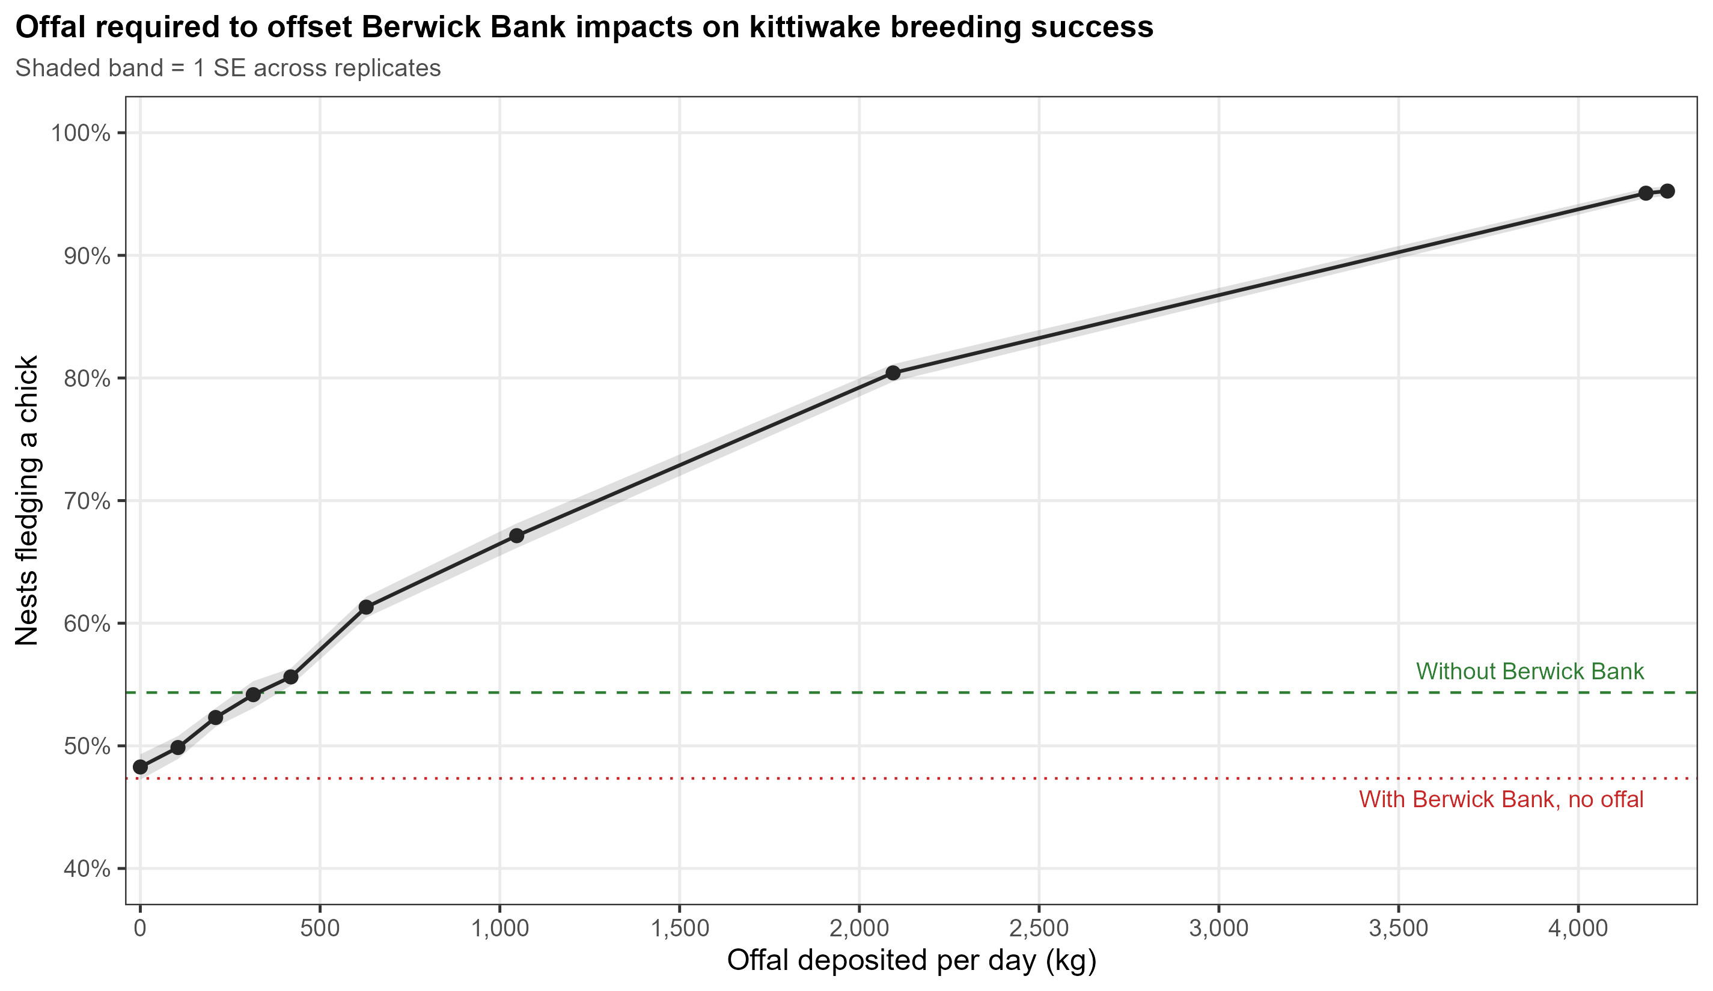
Results
 | Without Berwick Bank | With Berwick Bank, no offal | + 2000 kg offal/day | change
Productivity | 0.5434 | 0.4734 | 0.7922 | +0.319/nest (+67%)
Adult survival | 0.7986 | 0.7957 | 0.8754 | +0.080 (band method: +0.043)

Slide 5
Results
 | Without Berwick Bank | With Berwick Bank, no offal | + 2000 kg offal/day | change
Productivity | 0.5434 | 0.4734 | 0.7922 | +0.319/nest (+67%)
Adult survival | 0.7986 | 0.7957 | 0.8754 | +0.080 (band method: +0.043)
“Nest success proportion”
47.3% → 79.2% of pairs fledging a chick.
In this simulation, translates to approximately +1,934 chicks
"Proportion of adult birds surviving a moderate year (including winter)“
79.6% → 87.5% of adults survive the year.

Slide 6
Results
Berwick Bank compensated at approximately 327 kg/day

Slide 7
Results
Most of this benefit comes from the fact that the simulation forces an increasing percentage of the population to forage close to the colony (at the offal deposit) → less travel distance/barrier effects

Slide 8
Results
Most of this benefit comes from the fact that the simulation forces an increasing percentage of the population to forage close to the colony (at the offal deposit) → less travel distance/barrier effects
Further simulations needed:
Varying offal kg deposits and varying distances from the colony
Stochastic values of # of birds foraging at offal deposit
Tests should be re-run with higher repetitions for stronger power (>20 repetitions rather than current 10 per treatment) – run times increase substantially. Initial numbers should be treated as preliminary.

